Slide 1
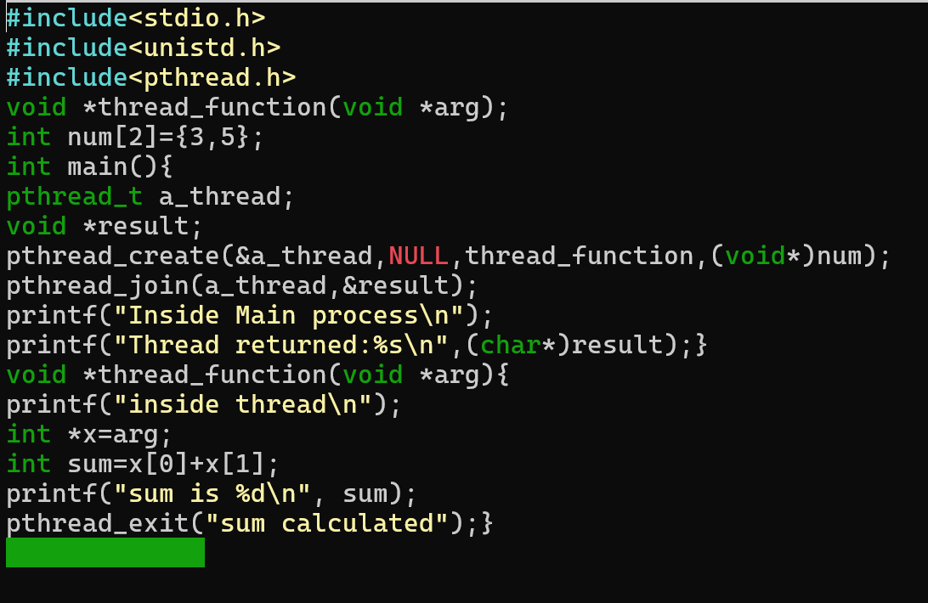
Q.1 Write a program to create a thread. Two number passes from main process, thread calculate sum of those and passes a message “sum calculated” to main process.
Exeriment-7

Slide 2
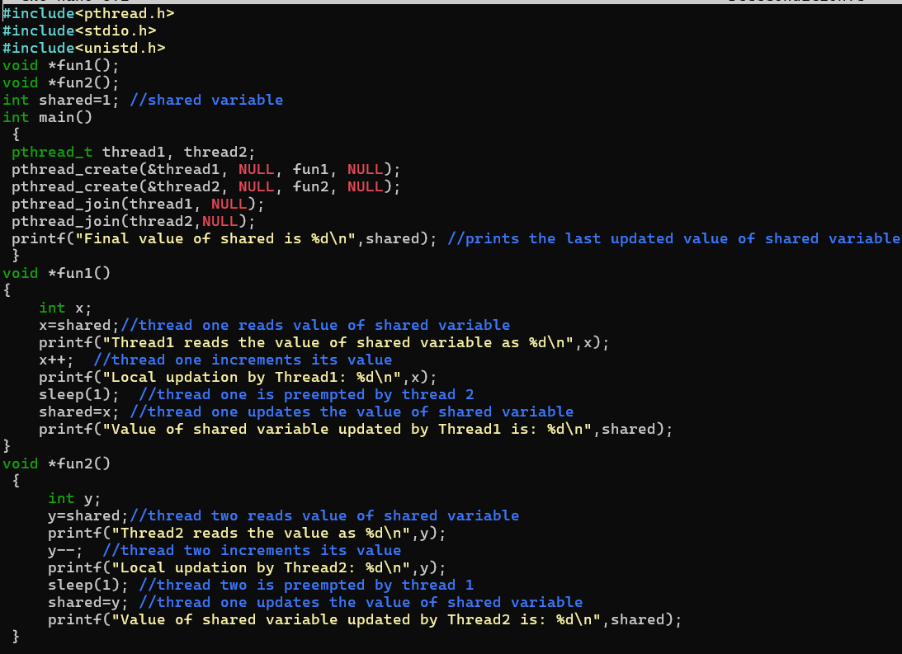
Write a c-program to create the Race Condition
Exeriment-8

Slide 3
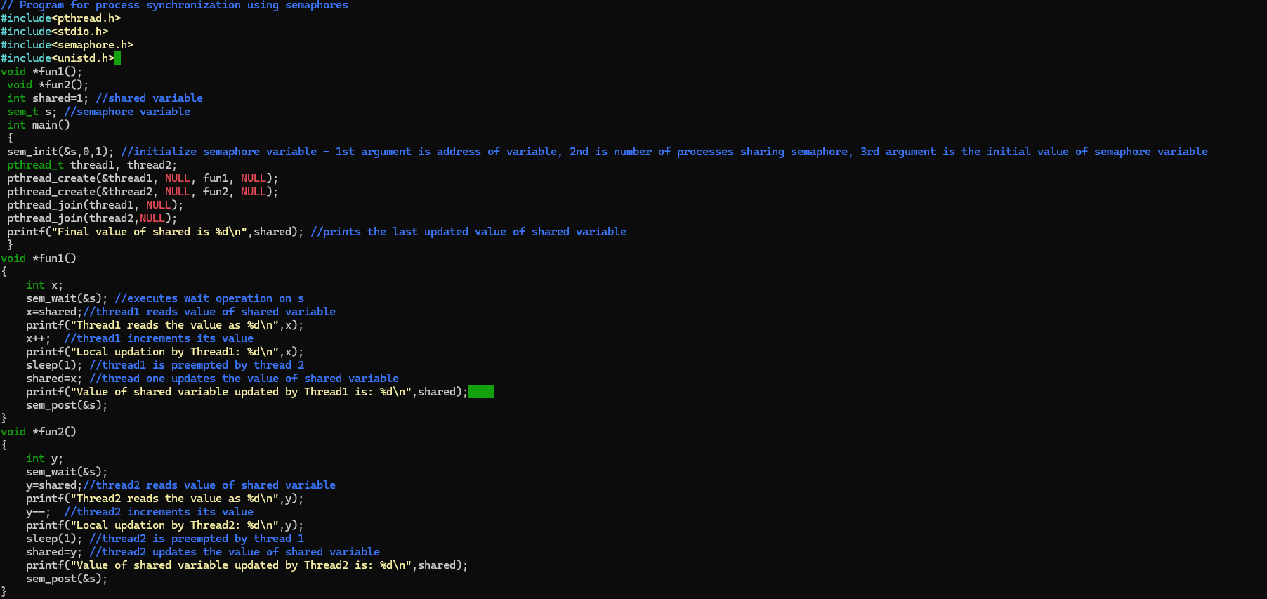
Write a c-program of Process Synchronization using Semaphore

Slide 4
Write a c-program of Process Synchronization using Semaphore

Slide 5
Needs to practice producer consumer process of lab exercise -7

Slide 6
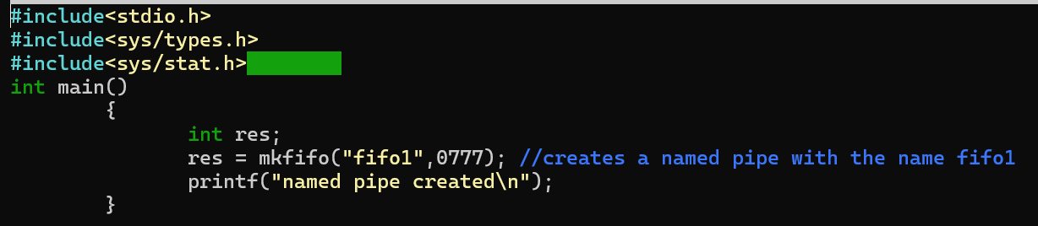
Write a program to perform IPC using “mkfifo” system call
Exeriment-8

Slide 7
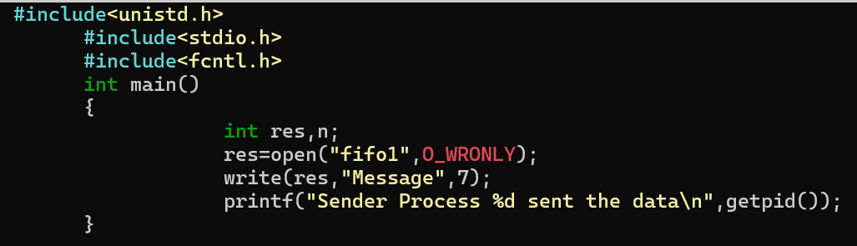
Sender code

Slide 8
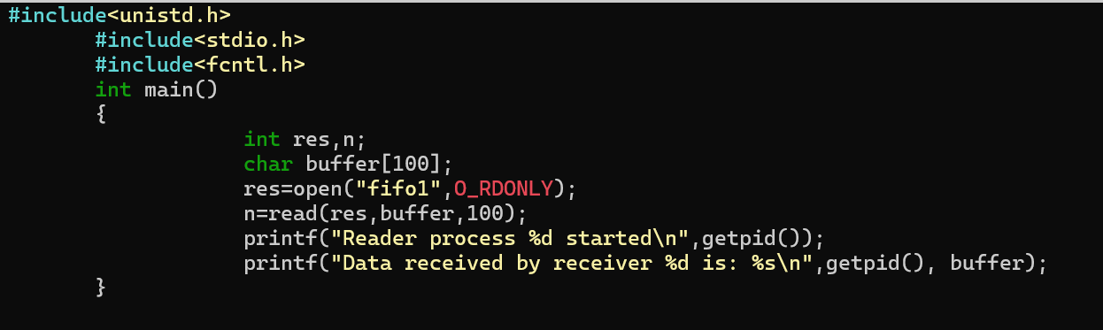
Receiver code

Slide 9
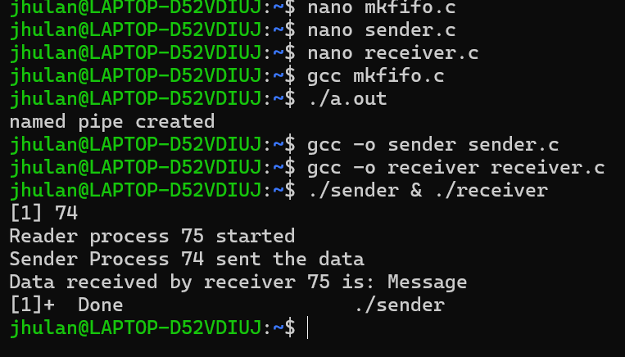
How to run: RUm mkfifo.c first then sender receiver code
Its works in a block mode means sender & receiver program should run together

Slide 10
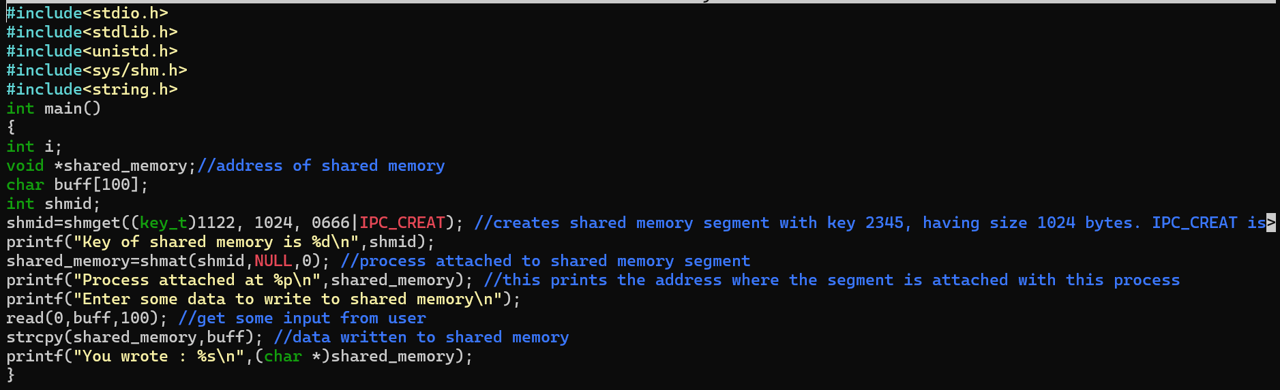
Sender code of shared memory
Write a program to perform IPC using shared memory.

Slide 11
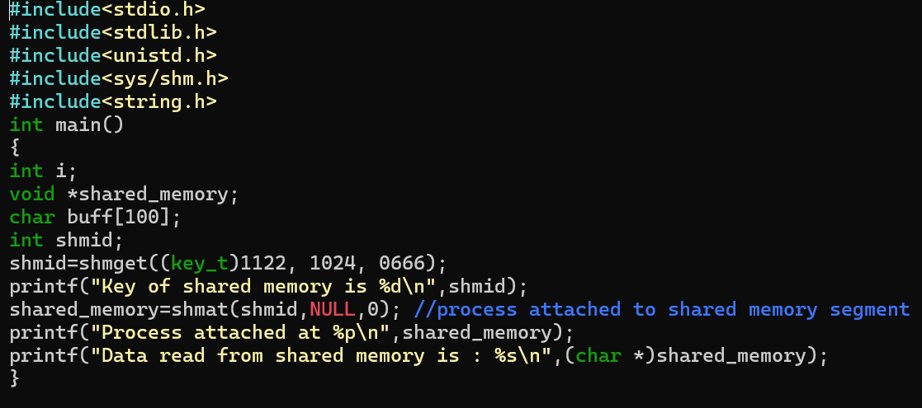
Receiver code of shared memory

Slide 12
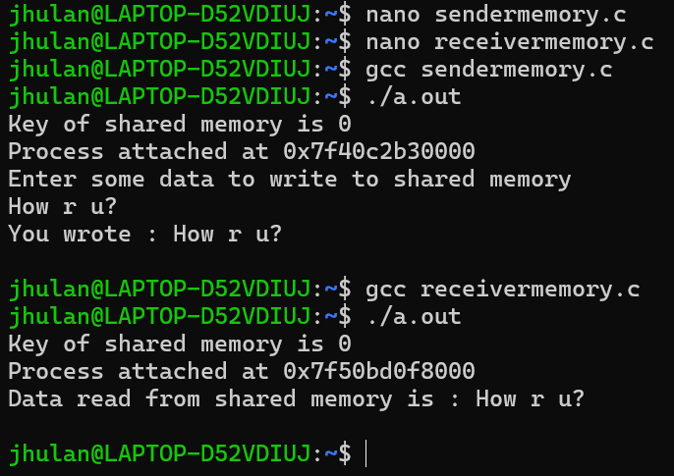
How to run:

Slide 13
Viva question:-
What is shell script?
What is thread?
Discus pthread_creat, pthread_joined, open system call syntax of read write sytem call etc.
Fork and wit system call etc.

